Slide 1



Basics of ML
Assignments
Dmitry Ryabokon, github.com/dryabokon

Slide 2
Scoring
A
90%
B
85%
C
75%
D
65%
E
60%
FX
<60%

Slide 3
Scoring
Assignment 1
Classic
Machine Learning
Assignment 2
Computer Vision and
Deep Learning
Tech Talk
Extra
50%
50%
+30%

Slide 4
Supervised Learning
Naive Bayesian Classifier
Gaussian Classification Model
Linear Discriminant Functions
Decision strategies
Benchmarking of Supervised Learning Algorithms
Unsupervised Learning
Classic ML

Slide 5
Supervised learning
Description
Assessment criteria
Get train/test data sample from open sources or generate it by yourself. Focus on low-dimension data, preferably 2 dimensions, 2 classes
Visualize the distribution of sample data
Estimate accuracy of data classification for 3-4 classifiers studied over lecture course
Build ROC curves and hit maps
In-house classifier: 20%
Out-of-box classifier: 20%
Data visualization charts: 20%
ROC curve charts: 20%
Docker image: 20%
* Extra: multi class championship 30%

Slide 6
Naive Bayesian Classifier
Description
Assessment criteria
Get train/test data sample from open sources, e.g. GBP/USD index. Use daily change (↑, ↓) as a target.
Visualize the distribution of sample data
Estimate accuracy of data classification
Build ROC curves and calculate AUC
In-house classifier: 20%
Out-of-box classifier: 20%
Data visualization charts: 20%
ROC curve charts: 20%
Docker image: 20%
* Extra: multi class championship 30%

Slide 7
Gaussian Classification Model
Description
Assessment criteria
Get train/test data sample from open sources, e.g. GBP/USD index. Use daily change (↑, ↓) as a target.
Visualize the distribution of sample data
Estimate accuracy of data classification
Build ROC curves and calculate AUC
In-house classifier: 20%
Out-of-box classifier: 20%
Data visualization charts: 20%
ROC curve charts: 20%
Docker image: 20%
* Extra: multi class championship 30%

Slide 8
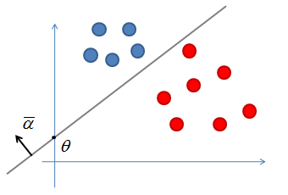
Linear Discrimination with SVM
Description
Assessment criteria
Get train/test data sample from open sources, e.g. GBP/USD index. Use daily change (↑, ↓) as a target.
Visualize the distribution of sample data
Estimate accuracy of data classification
Build ROC curves and calculate AUC
In-house classifier: 20%
Out-of-box classifier: 20%
Data visualization charts: 20%
ROC curve charts: 20%
Docker image: 20%
* Extra: multi class championship 30%

Slide 9
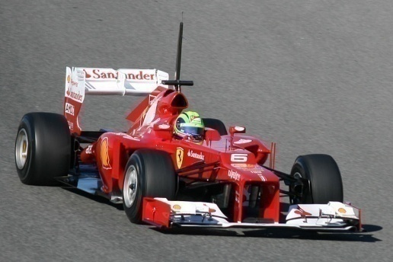
Decision strategies
Description
Assessment criteria
Get bet data from open sources
Visualize the distribution of sample data
Estimate accuracy of random, deterministic (host, visitor, challenger) and Bayesian strategies
Build ROC curves and calculate AUC
Engineer the predictive features and estimate their predictive power
Deterministic strategy: 20%
Random Strategy: 20%
Bayesian Strategy: 20%
ROC curve charts: 20%
Docker image: 20%
* Extra: predictive features 30%

Slide 10
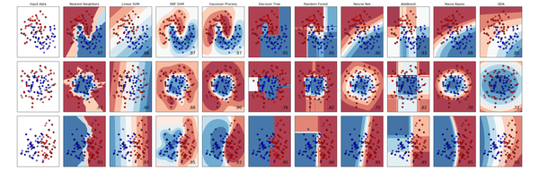
Benchmarking the Supervised Learning Algorithms
Description
Assessment criteria
Get data from open sources
Visualize the distribution of sample data
Estimate accuracy of different classifiers
Build ROC curves and calculate AUC
Engineer the predictive features and estimate their predictive power
Linear discriminant: 20%
Gaussian model: 20%
Other models: 20%
Data visualization charts: 20%
ROC curve charts: 20%
* Extra: multi class championship 30%

Slide 11
Unsupervised learning
Description
Assessment criteria
Get train/test data sample from open sources or generate it by yourself. Focus on low-dimension data, preferably 2 dimensions, 3-5 classes
Visualize the distribution of sample data
Visualize iteration of EM/K-Means algorithms
Estimate the accuracy of classification
In-house unsupervised classifier: 20%
Out-of-box classifier: 20%
Data visualization charts: 20%
Visualize the learning iterations: 20%
Docker image: 20%
* Benchmark results with some clustering algorithms 30%

Slide 12
Feature extraction
Transfer learning
Fine-tuning
Object Detection
Texture Segmentation
Stereo Vision
OCR
Feature Visualization
Deep Learning

Slide 13
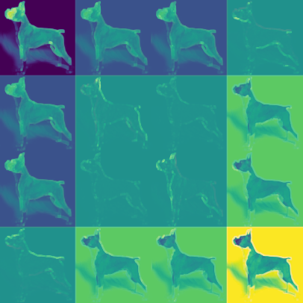
Feature extraction
Description
Assessment criteria
Get train/test data sample from open sources. Try both scenarios when classless are well separable and are not.
Run data thru various feature extractors and visualize the results, estimate the quality of clustering
Visualize the intermediate data of CNN: filters, layers
Build own extractor : 40%
Use existing feature extractors: 20%
PCA and TSNE charts: 20%
Benchmark quality of extractors: 20%
* Illustrate de-convolutions: 30%

Slide 14
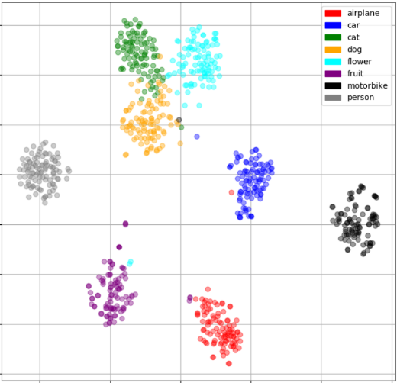
Transfer learning
Description
Assessment criteria
Benchmark accuracy of multiple classifiers (SVM, RF, LM, etc) applied on top of several feature extractors (AlexNet, VGG, ImageNet etc)
Research how accuracy very depending on the depth of the frozen layers, visualize this dependency
Build/visualize confusion matrices
Illustrate most typical classification errors
Build confusion matrices: 60%
Build the accuracy trend: 20%
Illustrate typical errors: 20%

Slide 15
Fine-tuning
Description
Assessment criteria
Benchmark accuracy of multiple CNNs finetuned on specific classes of images (e.g faces, cars)
Illustrate how internal parameters were optimized to maximize the classification accuracy
Build/visualize confusion matrices
Illustrate most typical classification errors
Build confusion matrices: 60%
Illustrate internal CNN data: 20%
Illustrate typical errors: 20%

Slide 16
Object detection
Description
Assessment criteria
Get train/test data sample from open sources or generate it yourself. Try on human faces, human shapes, cars, etc. Any type of object that you can capture with your laptop camera is preferable.
Train the detector and estimate the accuracy against the test set
Run detector in live mode, detect objects in video stream captured by a laptop camera
Build own detector: 40%
Use pre-trained detector: 20%
Precision-recall chart: 20%
Detecting objects in live mode: 20%
* Benchmark results with some alternative detectors 30%

Slide 17
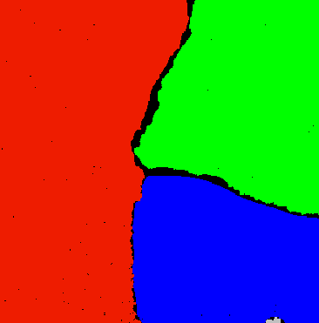
Texture Segmentation
Description
Assessment criteria
Get train/test data sample from open sources or generate it yourself. Try on human faces, human shapes, cars, etc. Any type of object that you can capture with your laptop camera is preferable.
Train the detector and estimate the accuracy against the test set
Run detector in live mode, detect objects in video stream captured by a laptop camera
Build own detector: 40%
Use pre-trained detector: 20%
ROC chart for 2 classes problem: 20%
Processing images in live mode: 20%
* Benchmark results with some alternative detectors 30%

Slide 18
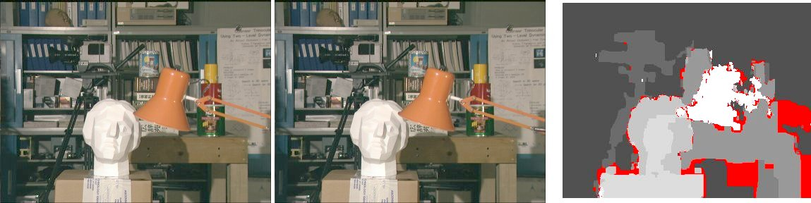
Stereo Vision
Assessment criteria
Assessment criteria
BM approach: 25%
SGBM: 25%
SIFT approach: 25%
Template Matching approach: 25%

Slide 19
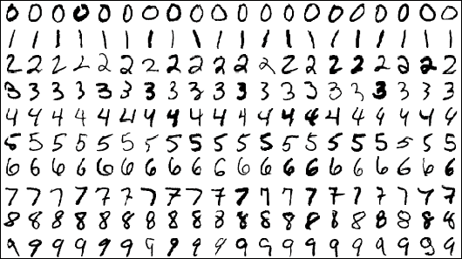
OCR
Assessment criteria
Build confusion matrices: 60%
Build the accuracy trend: 20%
Illustrate typical errors: 20%

Slide 20
Feature Visualization
Assessment criteria
Visualize convolution filters: 50%
Visualize layers: 50%
* Overview existing frameworks for feature visualization 30%

Slide 21
Object detection
Style Transfer
GAN
3D object reconstruction
Image to text
Segmentation
Colorization
Denoising
DeepFake
Pose Estimation
NLP
Tech Talks

Slide 22
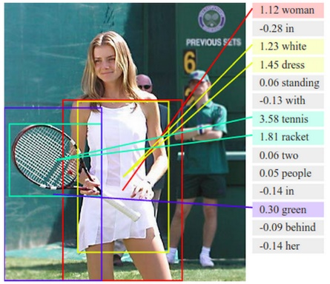
Tech Talks
Object detection
3D object reconstruction
Style transfer
Image
to text
GAN
Segmentation

Slide 23
Tech Talks
Colorization
Pose estimation
Denoising
NLP
DeepFake
More…

